Slide 1
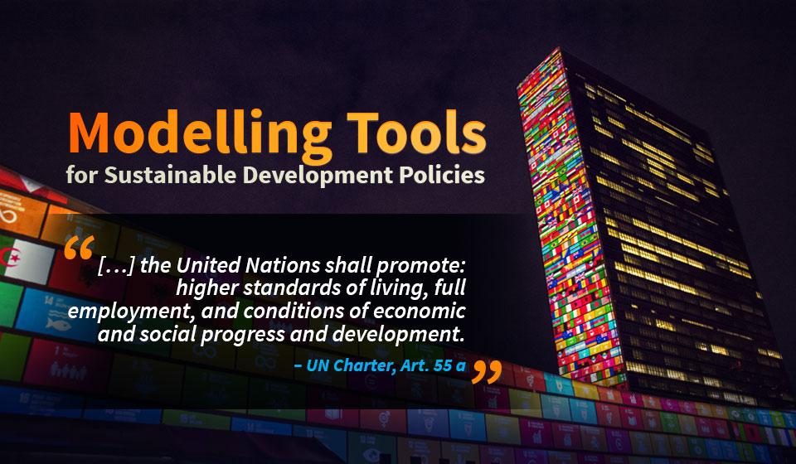

Slide 2
International commitments
June 2015: Sendai Framework for Dis­aster Risk Reduction 2015-2030
July 2015: Third International Conference on Financing for Develop­ment adopted the Addis Ababa Action Agenda
September 2015: Transforming our world: the 2030 Agenda for Sustainable Development
December 2015: Paris Agreement

Slide 3

The 2030 Agenda

Slide 4
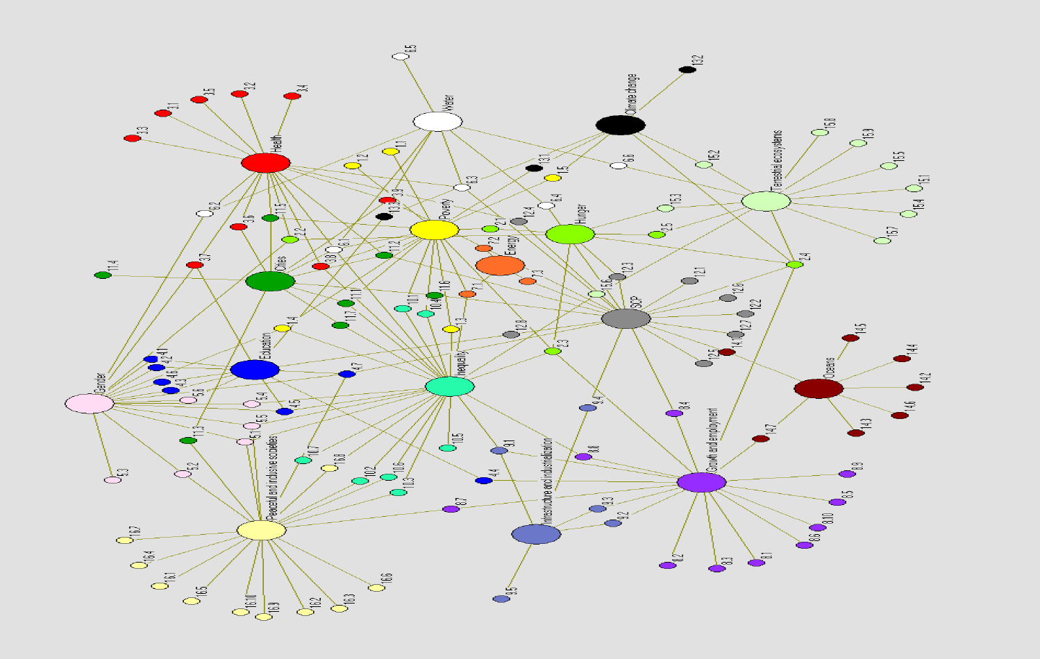
The 2030 Agenda and the SDGs
Notes:
This cross-references the SDGs. The numbers represent the times each cross-referencing is mentioned in the 2030 Agenda. See Leblanc, 2014.
The number of possible interlinkages between pairs of goals, when the direction of causality matters, is 272, and 28,392 between pairs of targets.
If two permutations of the 17 goals are considered, we have 250+ possibilities.
If two permutations of the 169 targets are considered, we have 28000+ possibilities.

Slide 5
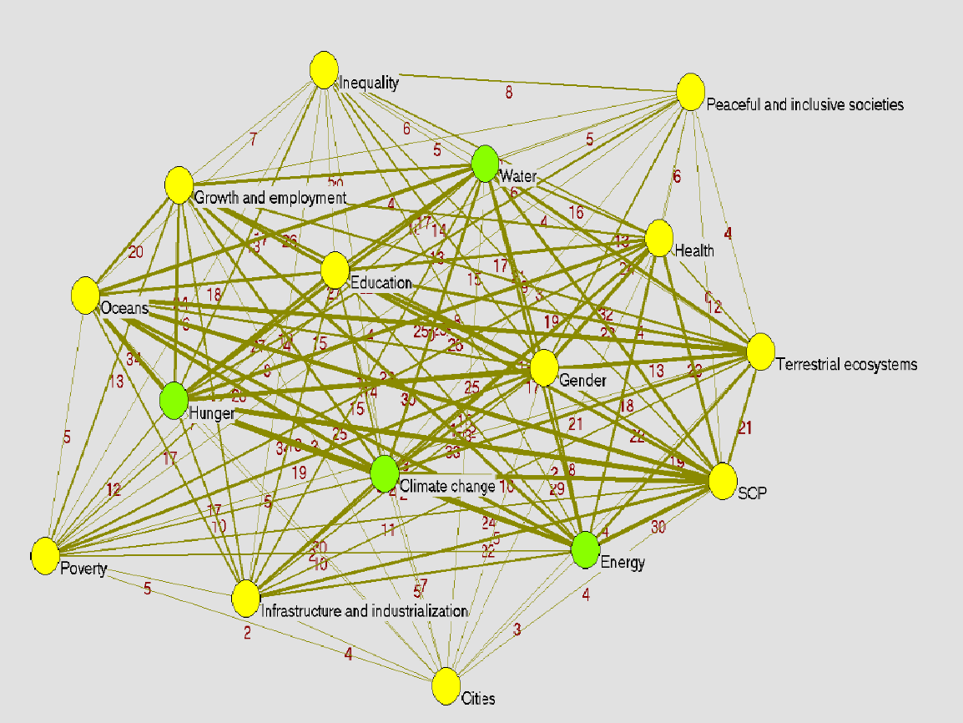
The 2030 Agenda, the SDGs and science
Notes:
These are the SDG interlinkages according to one science-based assessment. Taken from Leblanc, 2014.
When compared to the previous diagram, it is readily apparent that interlinkages across goals and targets are more dense.

Slide 6
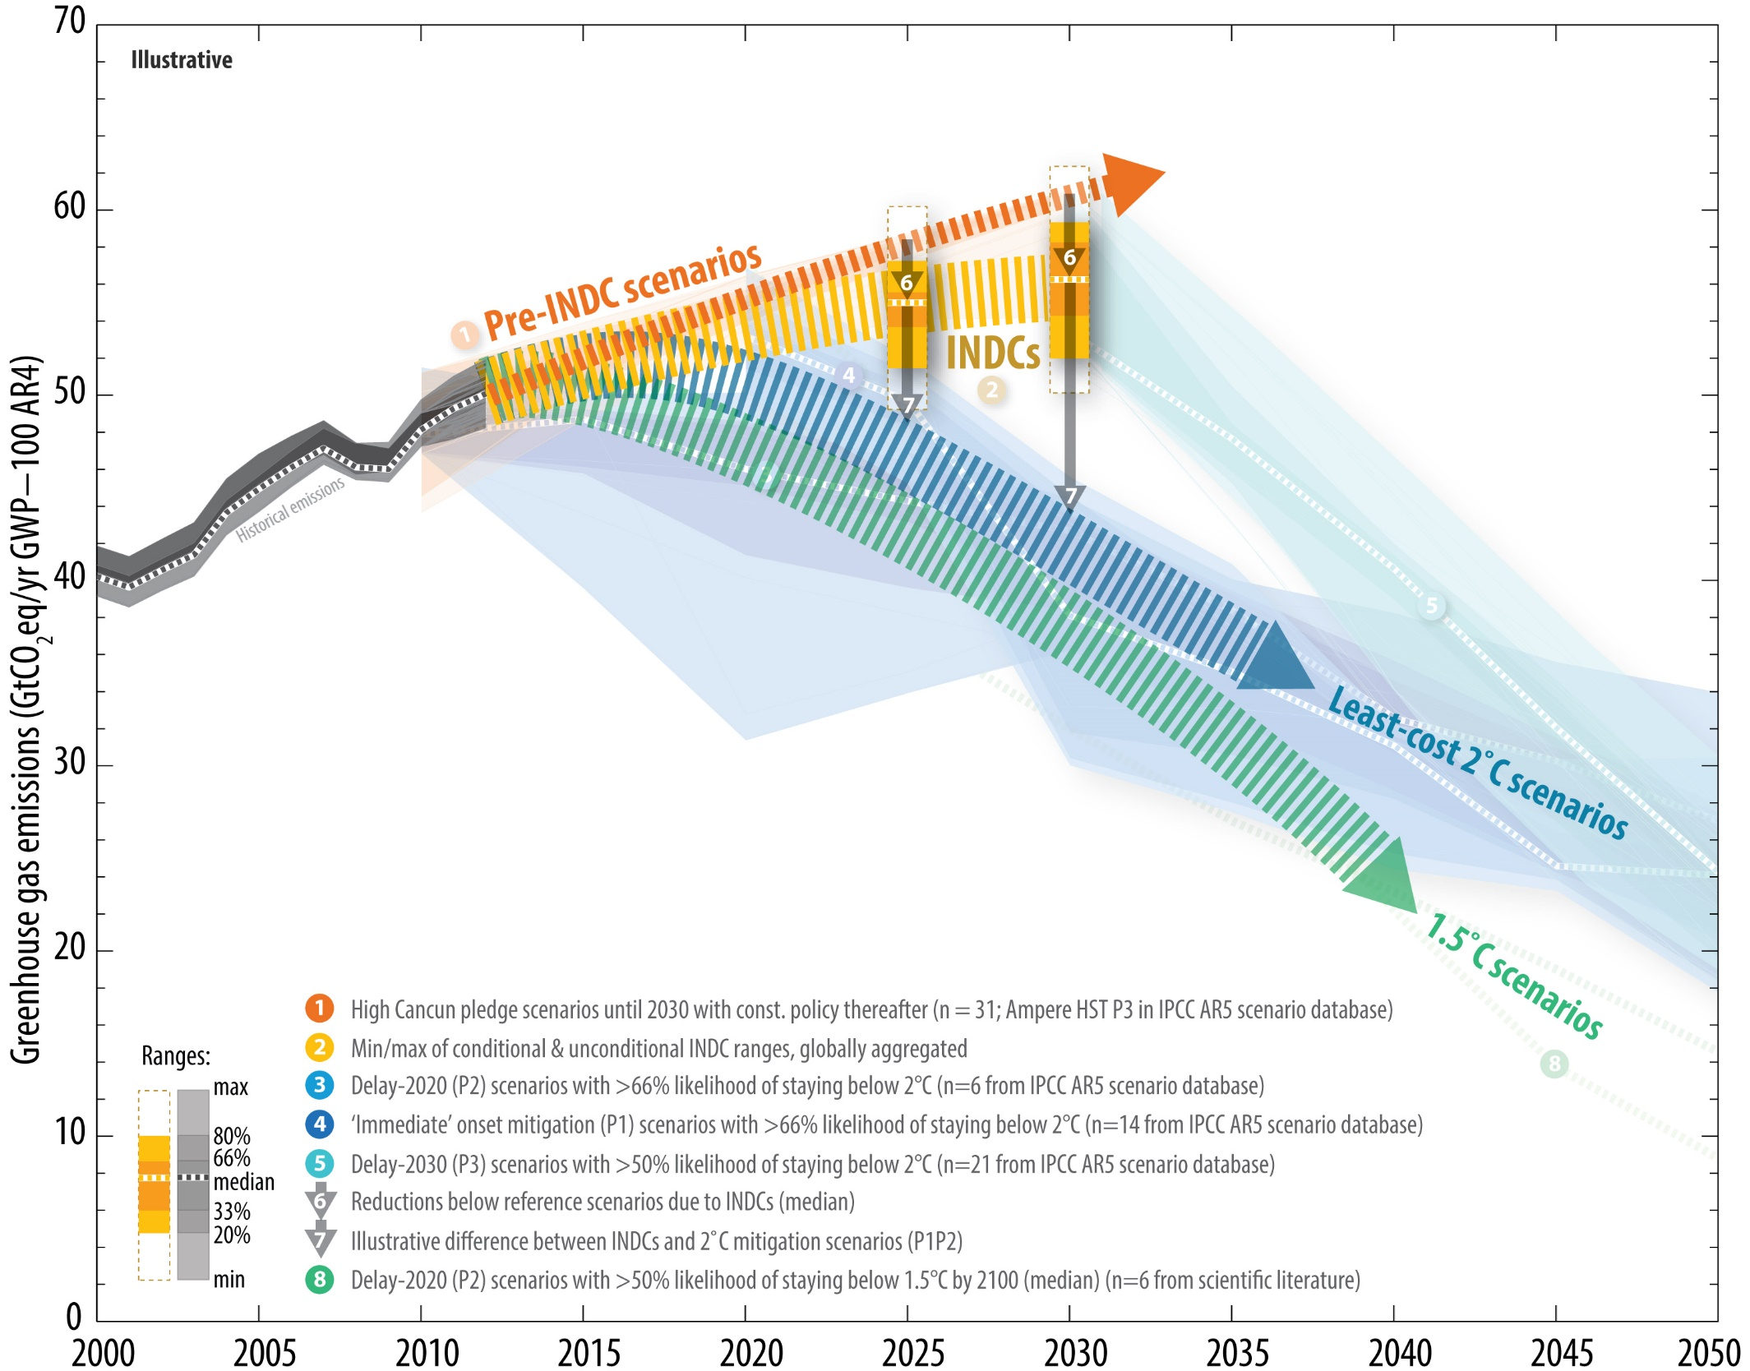
The challenges of the 2030 Agenda
Notes:
This shows the evolution of greenhouse gas emissions when emission reductions policies are undertaken, including those announced in the nationally determined contributions.
The two top outmost ranges in strong and weak orange represent trends associated with contributions announced by countries. The contributions represent a significant challenge for many countries, yet they are far from what will be needed to set the world on a path to prevent increases in global temperature higher than 2 degrees Celsius, in blue. Keeping the rise below 1.5 degrees Celsius is in green.
If the current contributions remain as they are, actions after 2030 will have to be drastic to keep temperature rise below 2 degrees. Remaining below 1.5 degrees will be almost impossible.

Slide 7
Heightened complexity
The challenge:
How to decide when linkages point in different directions
Need a way of measuring impacts to be able to compensate for trade-offs and complement with additional policy options
Global models
Give a sense of global consistency
Provide a reference for national policies
But cannot directly guide national policies

Slide 8
Modelling for sustainability: from global to national
Energy systems models
CGE global trade models
Global physical feasibility
sustainability investments
GLOBAL IAM
GLOBAL CGE or economy-wide
Global damage cost
well-being
CLIMATE MODELS:
EMISSIONS AND CLIMATE
National
sustainable
development
Policies
Geospatial electrification
National energy systems models
Integrated assessments; climate, land, energy, water systems
(CLEWS)
National CGE or economy-wide models
Microsimulation
Notes:
Global climate models started linking climate to human activity by linking emissions with climate. Early models date back to the early 20th century.
In the 1990s, integrated assessment models – which evolved from some energy systems models in the 1970s that sought to tackle the effects of rising oil prices – linked emissions to entire energy and economic systems. In some cases, feedback loops between energy and economic systems and climate were included. Similarly, economy-wide models used global trade models to link economic flows with climate models through emissions.
Downscaling global models to the national sphere might not be the best route.
More promising is to begin with national data, specific policy challenges and national parameters. A good starting point might be an integrated assessment model of the climate, land, energy and water systems. These models use the results of global climate models downscaled to countries to formulate plausible scenarios. They to do not, and should not, feature a feedback loop with climate.
Questions this model cannot address are likely to emerge quickly. A suite of models interplayed on an ad hoc basis can greatly assist in addressing these questions in an integrated way. The suite of models included in this course encompasses economy-wide, energy systems, electrification and microsimulation models.

Slide 9
Global models insights A sample
National policies
A sample
Rapid growth in developing countries and poverty eradication are both consistent with sustainability.
Energy for all is compatible with sustainable paths, with only marginal increase in emissions.
Tapping biofuels might reduce emissions but decrease biodiversity.
Preventing climate change, enhancing biodiversity and controlling air pollution are all achievable goals.
Nuclear energy can contribute but is not a must for arriving at a sustainable development path.
Poverty eradication
Reduced inequality
Higher living standards
Food security
Protecting the environment
Universal access to electricity
Renewable and clean energy
Affordable and reliable energy
Industrialization
Curbing emissions under nationally determined contributions
Energy security
Providing
context
Notes:
These are some of the insights provided by global integrated assessment and global economy-wide models. These insights provide a sense of what is feasible at a national scale.

Slide 10
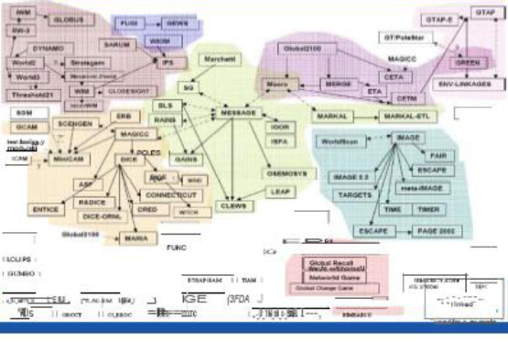
Genealogy of integrated assessment modelling
Notes:
There is a large number of system models. Energy systems models do optimization while others are more stock-flow models. There are also integrated assessment models. All models have strengths and weaknesses. This course favours models that are open-source code or at least those that analysts in governments of developing countries can access freely or under clear preferential schemes. The main criteria are strong transferability and strong research foundations.

Slide 11
Sustainable development
The food-energy-water nexus
National development policies
National sustainable
development policies
Food
Water
Energy
Food, energy and water systems are highly interlinked
Often referred to by the term nexus
Part of broader development challenge as reflected in the 2030 Agenda for Sustainable Development
Notes:
This slide shows a diagram of the food, energy and water nexus to illustrate multiple interconnections.
No attempt will be given here to explain the diagram in any detail.

Slide 12
CLEWS
An analytical framework and model
Energy model
Energy for water processing and treatment
Energy for water pumping
Energy for desalination
Water available for hydropower
Water for power plant cooling
Water for (bio-) fuel processing
Energy for fertilizer production
Energy required for field preparation and harvest
Biomass for biofuel production and other energy uses
Greenhouse gas emissions
Climate
Water model
Land-use model
Precipitation, temperature
Water for biofuel crops (rain-fed and irrigated)
Water needs for food, feed and fibre crops (rain-fed and irrigated)
Notes:
The diagram shows the main components of the CLEWS analysis and modelling. The CLEWS analytical framework and model are simple yet powerful for a national integrated assessment including the food, energy and water nexus.
CLEWS interlinks this nexus with climate factors and climate change scenarios. It provides output indicators relevant to climate change such as greenhouse gas emissions, and changes in area covered by forests, among others. But these outputs are not run through a climate change model. CLEWS uses expected changes in relevant factors such as water, land use and energy systems; examples include precipitation and temperature.
This slide is also included in the CLEWS module.

Slide 13
Addressing complexity
Modelling tools
Approach
Sound, adapted and based on NATIONAL development PRIORITIES.
A suite of models. No single model can cover all relevant issues.
Accessible, unrestrained from proprietary specification (open source).
User-friendly, communication effective.
Tapping research and the knowledge-creation communities.
Responding to demands for CAPACITY-BUILDING.
Socio- economic impact
Economy-wide
Integrated Assessment System Modelling
Energy systems
Integrated assessment system
Electricity for all
Notes:
At the United Nations Department of Economic and Social Affairs, early work on MDG modelling using economy-wide and socioeconomic impacts has been expanded to take into account interactions with energy and environmental dimensions. The approach to capacity development for using modelling tools has been shaped to include items listed in the slide, but will continue to incorporate other modelling tools as needed.

Slide 14
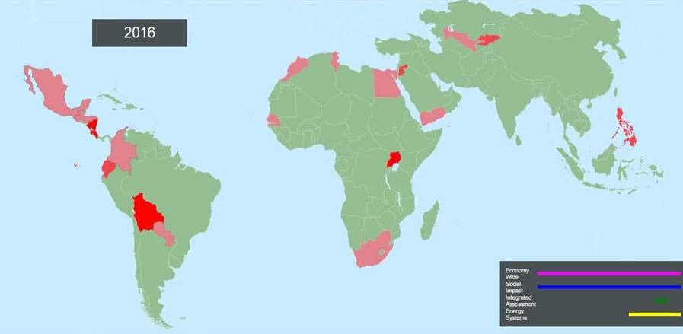
BUILDING ANALYTICAL CAPACITY FOR SUSTAINABLE DEVELOPMENT POLICIES
2005-2015
20 countries
2015-2017
Bolivia
Costa Rica
Ghana
Kyrgyzstan
Mongolia
Nicaragua
Paraguay
Uganda
Notes:
Since the early 2000s, the United Nations Department of Economic and Social Affairs has been supporting countries with the use of modelling tools to inform development policies. The experience has centred on the use of economy-wide models to assess MDG policies; social protection policies, such as cash transfers; and the impacts of shocks such as changes in food and commodity prices as well as the 2008 crisis.

Slide 15
PROJECT SCHEDULE OF ACTIVITIES: CLEWS
WORKSHOP I
40 hrs./each
WORKSHOP 2
40 hrs./each
WORKSHOP 3
40 hrs./each
WORKSHOP 4
10 hours
SCOPING
DATA
GATHER ING
WATER MODELLING
Data use
Scenarios
Interpreting
ENERGY MODELLING
Data use
Scenarios Interpreting
INTEGRATED MODELLING CLEWS
Data use
Scenarios Interpreting
- Insights from modeling
- Informing policy debate
- Outreach, disseminate
PUBL ICATIONS
WORK
AT
DISTANCE
WORK
AT
DISTANCE
WORK
AT
DISTANCE
ITERACTIVE MODEL BUILDING
1st year
2nd year
Notes:
This is a schematic representation of the implementation of a CLEWS capacity development project in a given country. Work between the workshops is critical. Technical experts who are trained are expected to accomplish specific tasks. Effective capacity development depends on the active engagement of government analysts in data collection and model building.

Slide 16
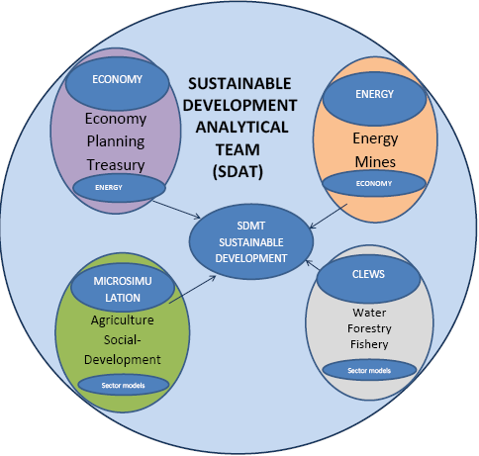
AWARENESS OF MODELLING MECHANICS, POWER AND LIMITATIONS
BUILDING INSTITUTIONS TO INFORM SUSTAINABLE DEVELOPMENT POLICIES
MODELS
ECONOMY-WIDE
MICRO-SIMULATION
SECTOR MODELS
MODELS
ENERGY
INTEGRATED
ASSESSMENT
SECTOR MODELS
Notes:
This is a schematic representation of how interministerial capacity-building on modelling tools, with clear emphasis and specializations, can help in achieving interministerial institutional integration for effective decision-making consistent with the 2030 Agenda and sustainable development policies.

Slide 17
THANK YOU

